Slide 1


DevOps Infrastructure & Git

Slide 2




Prerequisite
Use Workshop-VM / Workshop-Computer follow the instructions of the Boarding Pass
Visual Studio Code
https://code.visualstudio.com
Git
https://git-scm.com
Competence Team DevTech
Microsoft AL

Slide 3
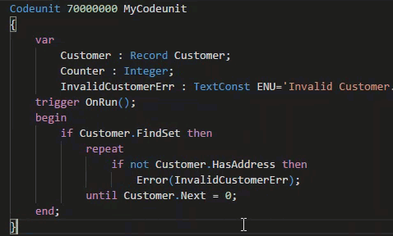
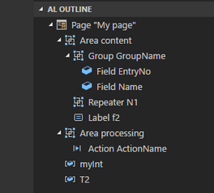
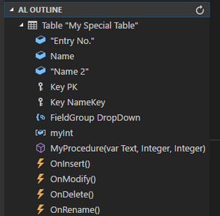
VS Code Useful Extensions
AL Formatter
Indentation
Keyword case style
Sort variable definitions
Readability Guidelines - Spacing and newlines (experimental)
AL Code Outline
Outlining – AL Object Structure
“Create List Page” from Table
“Create Card Page” from Table
al-util
“Rename & Move” Objects
Templates e.g. “Readme.md”

Slide 4


1
Introduction Git
2
Project Start
AGENDA
3
BERATUNGSPHILOSOPHIE
4
WARUM MICROSOFT?
5
WARUM COSMO CONSULT?
6
KUNDEN VON COSMO CONSULT
7
COSMO CONSULT INTERNATIONAL / GLOBAL SERVICE

Slide 5

Git
Commands, Branch, Hands-On
5

Slide 6
Git www.GitHub.com
What is Git?
Distributed version control system
Tracking changes on files
Used for source code management
Strong support for non-linear development
Rapid branching and merging / a branch is only a reference to one commit
Help to coordinate work among multiple people
Distributed development
Local copy of the full development history and changes
Efficient handling of large projects
Very fast and scalable

Slide 7
Git & MS Dynamics .../Getting-Started-Git-Basics
Replace In-Db Version Control of Dynamics NAV
Tracking of Changes (What / Where / Who)
File Types
Primary Track changes in TXT-Files!
Binaries supported BUT avoid FOBs
Directories & Files
.git contains the version information metadata of the repository
.gitignore exclude files and directories from Git
Branching
Development within same objects at the same time
Almost automatic merging of changes

Slide 8
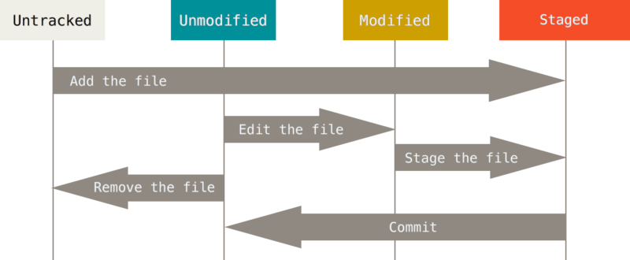
Git – Recording Changes to the Repository
Create Repository
Add Files
no empty Directories
Status: Staged
Commit Changes
Unmodified files
Source: https://git-scm.com/book/en/v2/Git-Basics-Recording-Changes-to-the-Repository

Slide 9
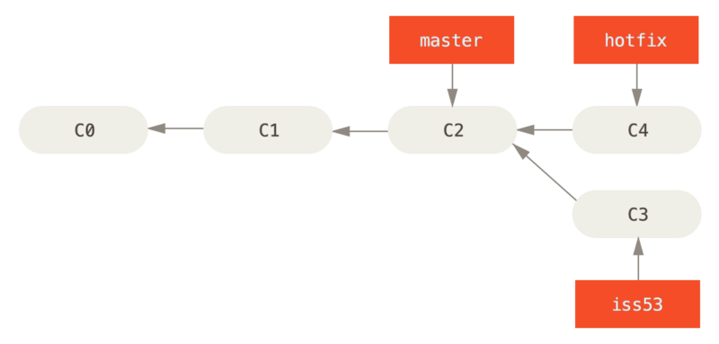
Git – Branches
Create a Branch
Track isolated changes
Switch between Branches
Change the current View of Branch file(s)
Latest tracked Version of Branch file(s)
Merge Branches
Combine the changes of 2 Branches since Fork Commit
Source: https://git-scm.com/book/en/v2/Git-Branching-Basic-Branching-and-Merging

Slide 10
Git .../common-git-commands.html Common Commands Cheat-Sheet
git init
Turns a directory into an empty Git repository
$ git init
git add
Adds files in the to the staging area
$ git add <file or directory name>
git commit
Record the changes made to the files to a local repository
$ git commit -m "Commit message in quotes"
git status
This command returns the current state of the repository
$ git status
git config
Configure the Git Settings e.g. „user.name“ and „user.mail“
$ git config <setting> <command>
git branch
To determine what branch the local repository is on, add a new branch, or delete a branch.
$ git branch <branch_name>
git checkout
To start working in a different branch, use git checkout to switch branches.
$ git checkout <branch_name>

Slide 11
Git .../common-git-commands.html Common Commands / Remote Repository Commands Cheat-Sheet
git merge
Integrate branches together.
$ git merge <branch_name>
git log
Show the chronological commit history for a repository.
$ git log
git remote
To connect a local repository with a remote repository.
$ git remote <command> <remote_name> <remote_URL>
git clone
Create a local working copy of an existing remote repository
$ git clone <remote_URL>
git pull
This pulls the changes from the remote repository to the local computer.
$ git commit -m "Commit message in quotes"
git push
Sends local commits to the remote repository.
$ git push <remote_URL/remote_name> <branch>

Slide 12
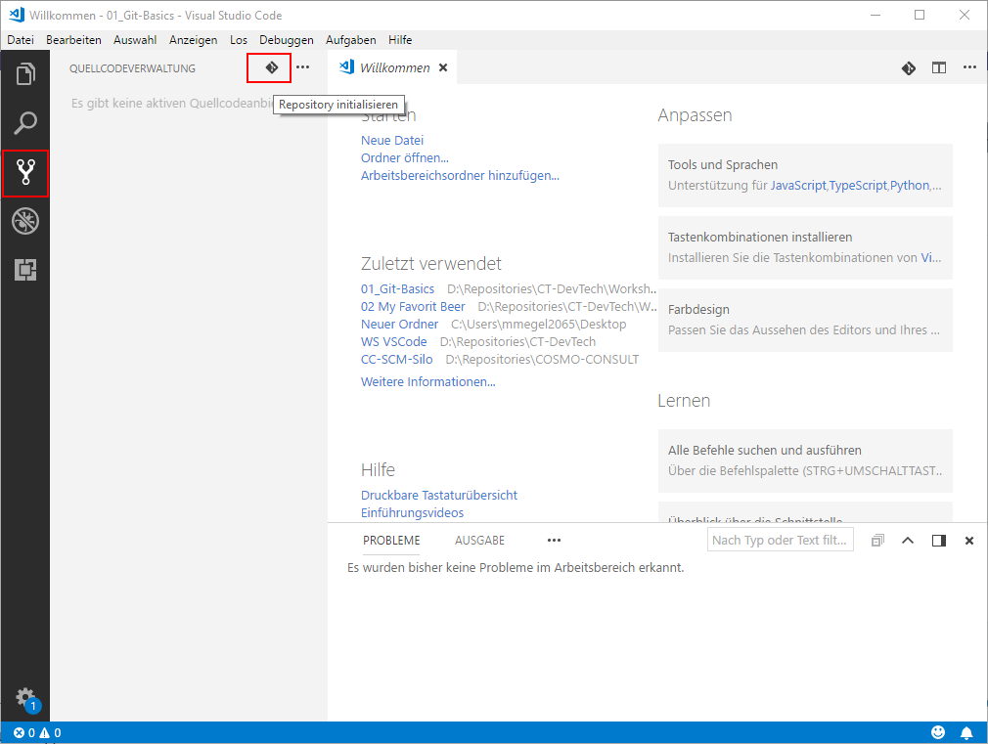
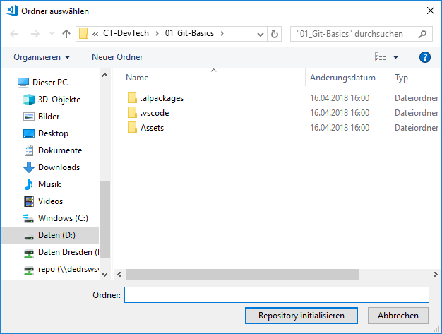
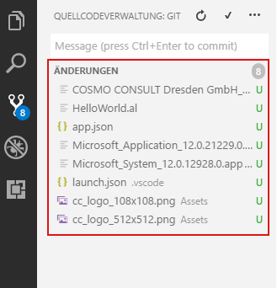
Git with VS Code
Initialize the local Git repository
Select Folder
„Initialize Repository“
Files will be recognized as „Untracked“

Slide 13
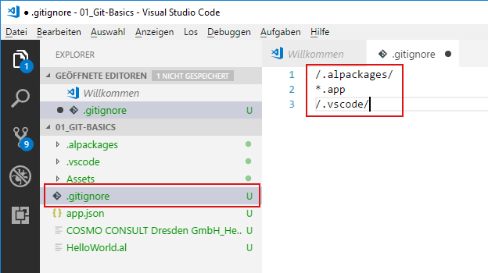
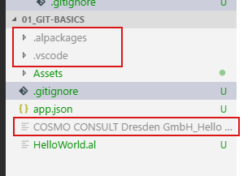
Git with VS Code
Create the “.gitignore” File
Ignore Files & Folders from Repository
Ignored Files
Symbols & Dependencies in “.alpackages” use Download from Server
Package File “*.app” created by compile
Workspace Settings in “.vscode” e.g. “launch.json”

Slide 14
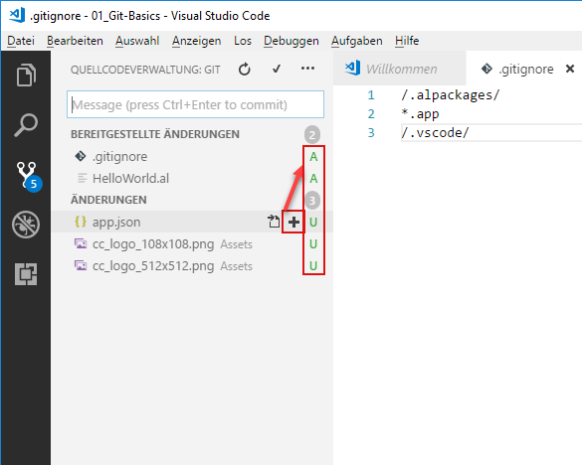
Git with VS Code
Add Files
Mark as „Staged“
Commit
Commit Message
Configure „user.name“ & „user.mail“

Slide 15
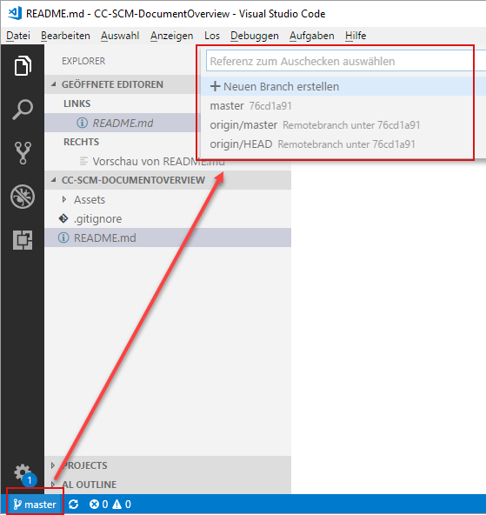
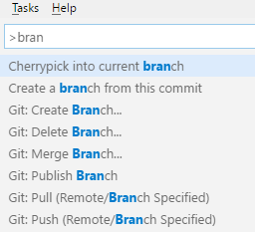
Git with VS Code
Create / Switch Branch
Use Command Palett [Ctrl] + [P] or [F1] → enter „BRANCH…“
Use Status Bar → click on your current Branch e.g. „master“
Pull / Push
Use Command Palett [Ctrl] + [P] or [F1] → enter „PULL…“ / „PUSH…“

Slide 16

Hands On

Slide 17
Git Hands On
Material
Project Skeleton „03-DevOps-Git\Starter\COSMO-CONSULT-1\”
Project Skeleton „03-DevOps-Git\Starter\COSMO-CONSULT-2\”
Project Skeleton „03-DevOps-Git\Starter\COSMO-CONSULT-3\”
Prerequisites
Connect to your Workshop VM → use Instructions on your Workshop Boarding Pass
Hand On - Tasks
Achieve common development related tasks with the Git command line
Achieve common development related tasks with the VS Code and the Git Integration
Achieve common development related tasks with the a 3rd Party Tool

Slide 18
Git – Hands On Use the Git command line
Open folder „…\03-DevOps-Git\Starter\COSMO-CONSULT-1” in Git Bash / Command Line
Open the folder “COSMO-CONSULT-1“ also in VS Code
Init the Repository
Add File(s)
Commit File
Check your Git-Config (Username / User-Email) ☺
Create Branch „feature“
Add or Change File(s) & stage File (git add)
Commit File
Switch between branches „master“ and „feature“
see the difference
Merge branch „feature“ into „master“
$ git init .
$ git add *
$ git commit –m "initial commit"
$ git config user.email "my@emailaddress.com"
$ git config user.name "Jon Doe"
$ git branch "feature"
$ git checkout "feature"
$ git add *
$ git commit –m "comment your changes"
$ git checkout "master"
$ git checkout "master"
$ git merge "feature"

Slide 19
Git – Hands On Use VS Code git integration
Open folder „…\03-DevOps-Git\Starter\COSMO-CONSULT-2” in VS Code
Init the Repository
Create a “.gitignore” file to ignore Symbols, Packages and the “.vscode” folder
Add the other project File(s)
Commit File
Check your Git-Config (Username / User-Email) ☺
Create Branch „feature“
Add or Change File(s) & stage File (git add)
Commit File
Switch between branches „master“ and „feature“
see the difference
Merge branch „feature“ into „master“

Slide 20
Git – Hands On Use a 3rd Party Tool (e.g. Smart GIT form syntevo) for your Git workflow
Open the folder „…\03-DevOps-Git\Starter\COSMO-CONSULT-3” in VS Code
Add and Init the Repository („…\03-DevOps-Git\Starter\COSMO-CONSULT-3”)
Ignore Symbols, Packages and the “.vscode” folder
Add the other project File(s)
Commit File
Check your Git-Config (Username / User-Email) ☺
Create Branch „feature“
Add or Change File(s) & stage File (git add)
Commit File
Switch between branches „master“ and „feature“
see the difference
Merge branch „feature“ into „master“

Slide 21

Infrastructure
Docker, NAV-Container-Helper
21

Slide 22
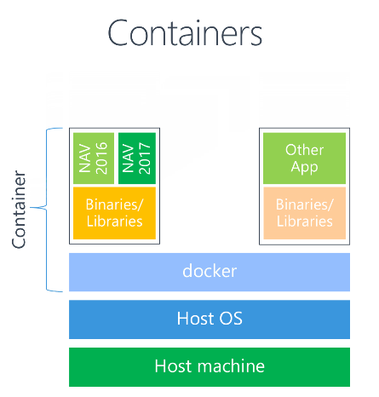
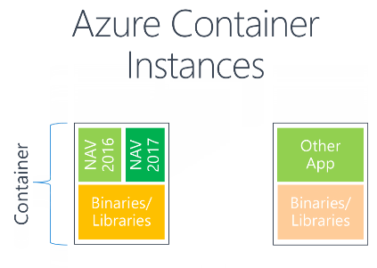
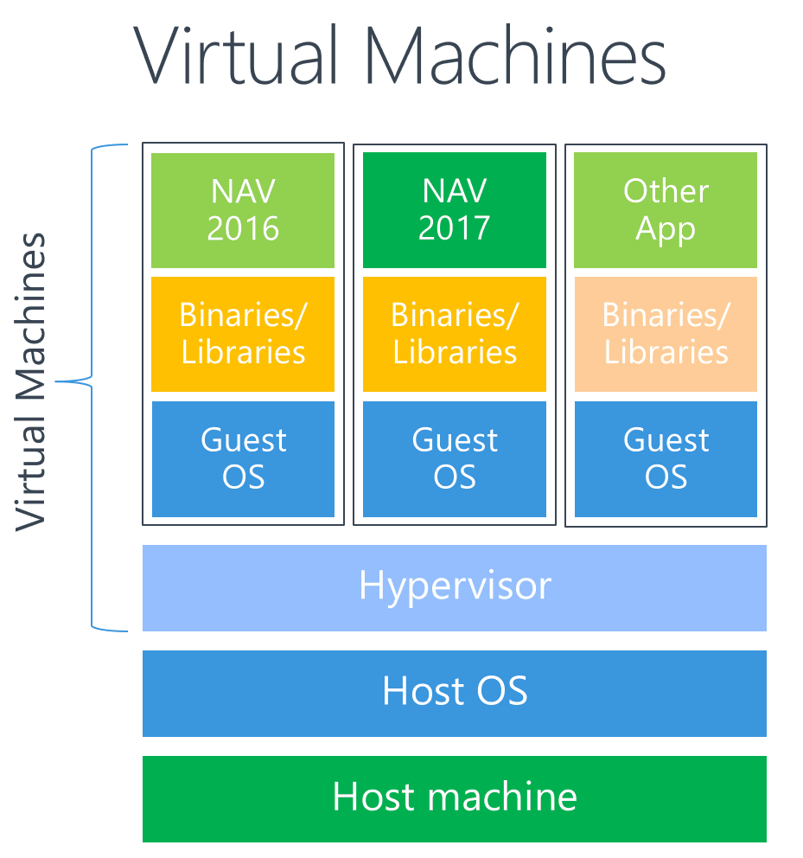
Infrastructure | Docker
NAV in Containers
Source: https://blogs.msdn.microsoft.com/freddyk/2017/10/31/what-is-docker-what-are-containers/

Slide 23
Infrastructure | Docker
Docker
Local Environment to run the Database & NST
NAV version
NAV Container Helper

Slide 24
Docker Common Commands Cheat-Sheet
List all containers
$ docker ps -a
List all images
$ docker images -a
Fetch the logs of a container
$ git logs <container ID or Name>
Kill a container
$ docker kill <container ID or Name>
Remove a containers
$ docker rm <container ID or Name>
Remove a container image
$ docker rmi <image ID>
To start working in a different branch, use git checkout to switch branches.
$ git checkout <branch_name>

Slide 25
NAV Container Helper Common Commands Cheat-Sheet
List common Commands
$ Write-NavContainerHelperWelcomeText
Create new C/SIDE development container
$ New-CSideDevContainer
Create new Nav container
$ New-NavContainer -accept_eula -containerName <name> -imageName "Microsoft/dynamics-nav:2018-cu4-de"
$
$
$
$

Slide 26
ZUKUNFTSFÄHIGE LÖSUNGEN
Innovation & Beständigkeit
26

Slide 27

Q & A
Competence Team DevTech
Channel Microsoft AL

